Slide 1
Increase Automation to REST
Understanding Web Services and how to test them
Shiva..

Slide 2
Expectations
What are you hoping to get from this session?

Slide 3
Key Take Aways:
What Web Services are and why we use them
How to test a Web Service in multiple ways
Increased familiarity with test automation
Notes:
Shiva:
What are WebServices; Importance of Web Services
Learn How do we test a WebService using different tools and programming libraries
Get familiarised with automating WebService.

Slide 4
Web Services
A functionality to be offered over Web.
Uses HTTP/HTTPS/SMTP for communication
Communicates using JSON/XML/CSV/Plain Text etc.

Slide 5
When and Why
Same functionality multiple UIs:
Customise cross platform
Multiple apps
Different vendors
Being able to implement one service and use that functionality across all these different displays
Notes:
Shiva: Application A is written in 1 framework may be JAVA and SPRINGS, can use service available in other application.

Slide 6
Let see an example!
...things get clearer when you can see them :)

Slide 7
An Example
Booking a ticket with Orange Bus via different agencies
RedBus UI
TravelYaari UI
Orange Bus UI
Get bus details
Book
a seat
Book
a seat
Orange Bus Web Service
Notes:
Shiva

Slide 8
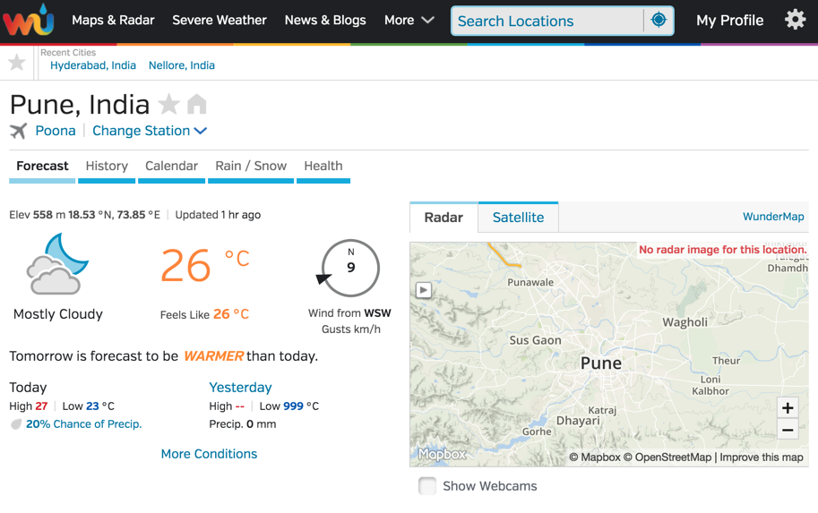
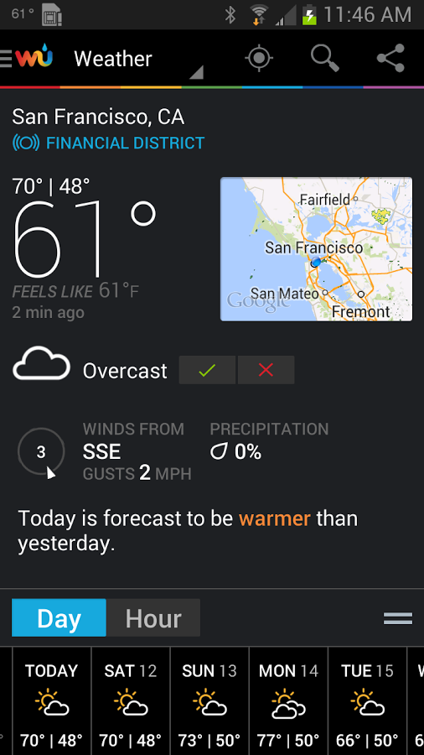
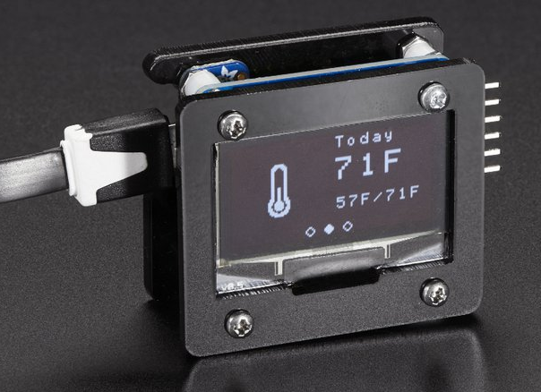


Another Example
https://learn.adafruit.com
curl -X GET http://api.wunderground.com/api/68826afac600251b/conditions/q/zmw:00000.18.43063.json

Slide 9
REpresentational State Transfer (REST)
Uses HTTP(S) for CRUD operations
Uniform Resource Identifiers (URIs)
New alternative to SOAP
Notes:
REST is one architectural approach to web services which is growing in popularity.
It uses moslty the HTTP(S) protocol for CRUD functionality: creation, reading, updating and deleting of resources.
URIs are the id of some data which is being referred to in the requeste
SOAP (Simple Object Access Protocol) is a protocol with uses XML. Its an alternative to REST. SOAP was popular previously but systems built more recently would often be design in a RESTful way so we are seeing less and less SOAP now.

Slide 10


Statelessness
Client
Load Balancer
Node 1
Node 2
Notes:
A request cannot be dependent on a past request and a service treats each request independently.
Assuming the system has enough load to require more than 1 node … which is pretty common … its important to consider how to handle the likely even where the first and second request go to different nodes or instances of the web service. A key part of a restful architecture is that each request from any client contains all the information necessary to service the request
For instance a real world physical example, lets say we walk into a store, they are a huge company with stores all over the globe and thousands of staff members. We make an order with this company and they provide us with an id. If we want to check the status of this order we might not find outselves chatting to the exact staff member again, or they might have served another customer since then and forgotten us, it could be whichever staff member is free, or we might be in a different store. In order for the staff member to be able to responde to our status request we need to provide some information again along with the request. These staff members are like the nodes, they will all be looking at the same system to get your status, you walked into the same store or called the same number, but the nodes or staff themselves are individuals. So they need context on how to help you.

Slide 11



API/Service Layer
Presentation Layer
Presentation Layer
Presentation Layer
API Layer
Business Layer
Notes:
Shiva:

Slide 12
What are APIs?
Part of the web service which receives requests/sends responses
Has one or more endpoints
Documented contract
Notes:
Shiva
Mention “Application Programming Interface” - API

Slide 13
Requests and Responses
...lets see some examples...

Slide 14
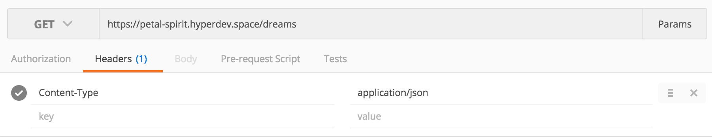
Request
Request:
URI
Method
Headers
DATA
https://dreamstw.herokuapp.com/dreams/
Notes:
Shiva
Separate slide for request and response.
Consider using a screenshot of postman.

Slide 15
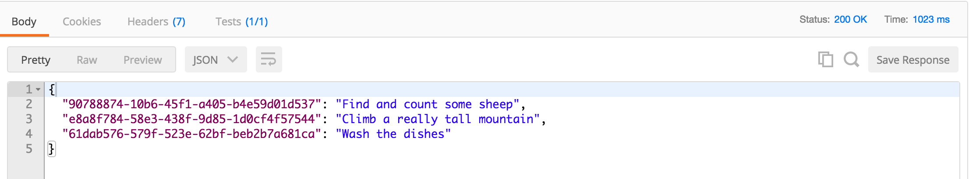
Response
Response
Response Code
Headers
Data
Notes:
Shiva
Separate slide for request and response.
Consider using a screenshot of postman.

Slide 16
Requests
Common request types:
GET
POST
PUT
DELETE
Notes:
Fiona
Get - request a resource, header might be used to specify some conditions similar to a query. Should only read data and shouldnt effect its state.
Post - provides some resource (or data) which the service will handle, could override, update, append, act upon...
Put - provides some resource which will be placed exactly at that URI location. If there is something already put there it will be overridden
Delete - removes the resource at the URI location. Could be stopped by the server but ideally shouldn't say it succeeded unless that resource was deleted but technically could

Slide 17
Response Codes
Outcome of a request:
1xx - Informational
2xx - Success
3xx - Redirection
4xx - Client Error
5xx - Server Error
Notes:
Fiona
There are a lot of potential responses but they can be grouped into these 5 main types. Error codes starting with there initial numbers help you to know which type they are. Lets cover some of the most common/important ones in more detail

Slide 18
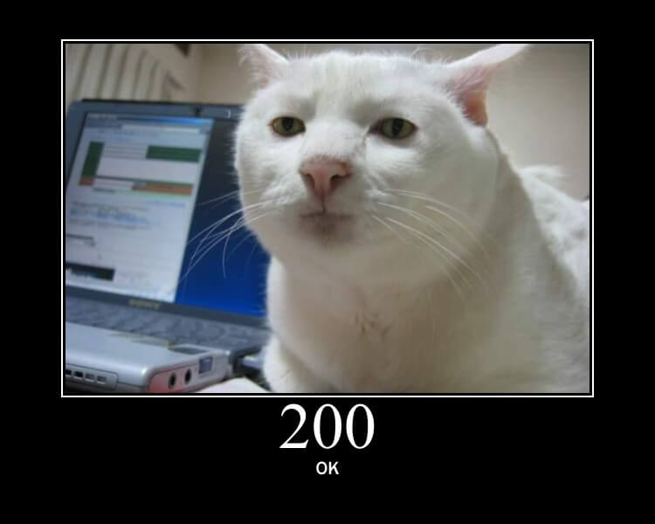
https://http.cat/
Notes:
Success! Your request was fulfilled.

Slide 19
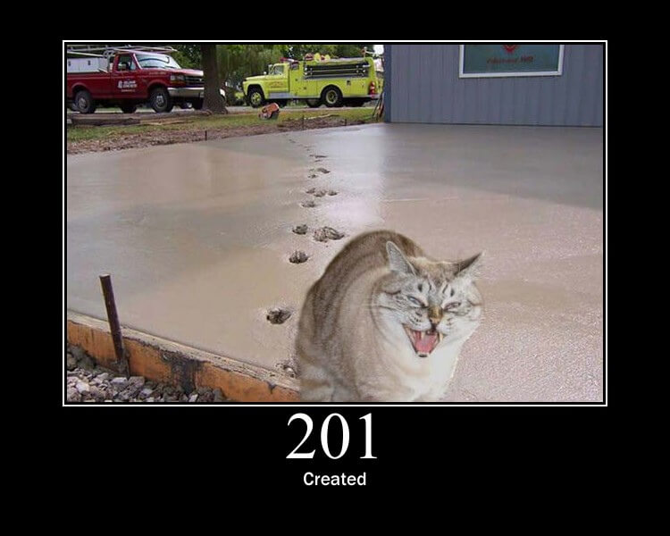
https://http.cat/
Notes:
Success! This request caused something to be created/added/updated successfully. Most likely you posted some data which cased this response

Slide 20
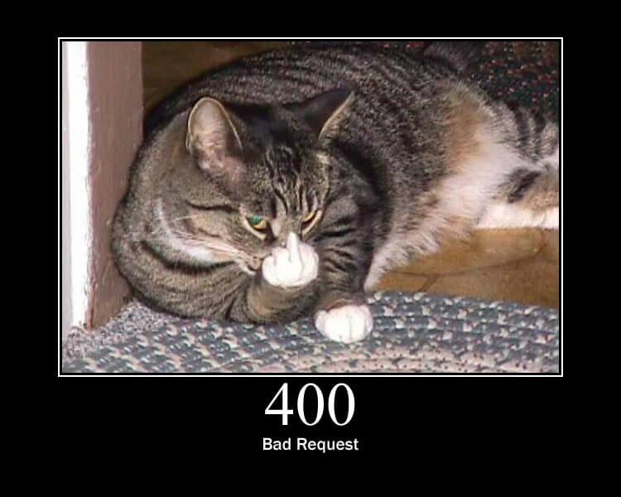
https://http.cat/
Notes:
Error, Oops, something went wrong. Seems like there’s a problem with the request you made.

Slide 21
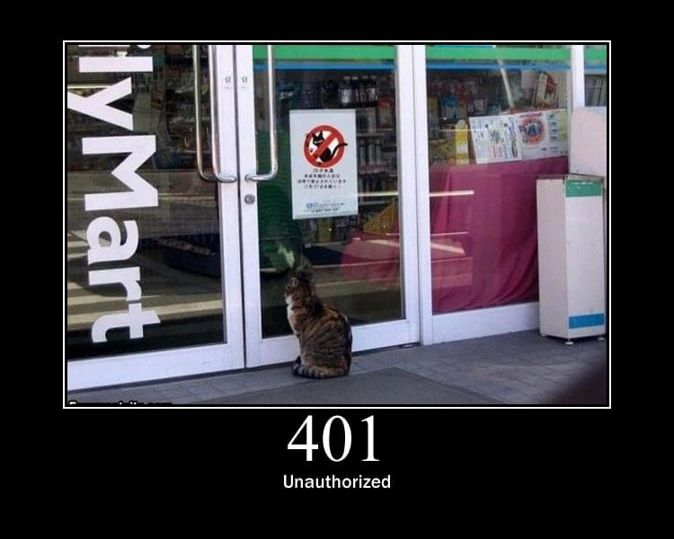
https://http.cat/
Notes:
Error, Oops, something went wrong. Seems that you arent permitted to do that request or arent correctly proving your right to perform that request

Slide 22
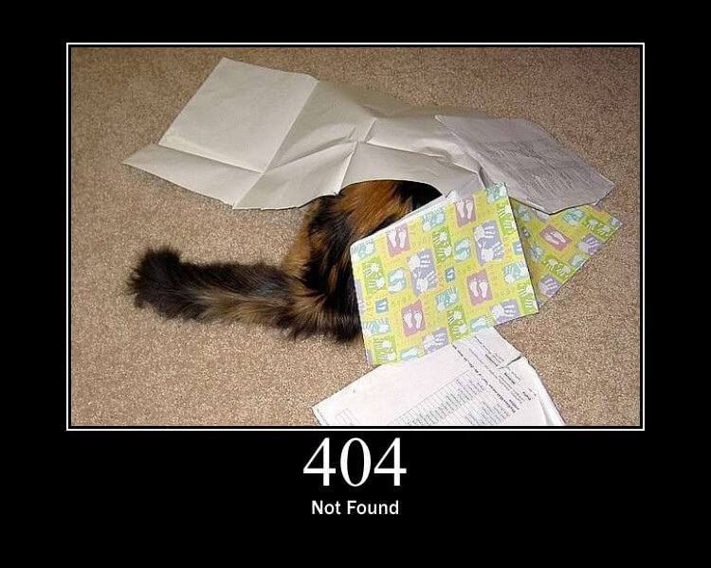
https://http.cat/
Notes:
Error, Oops something went wrong. Seems that the request is correct and you have the permission but the thing you asked for isnt there

Slide 23
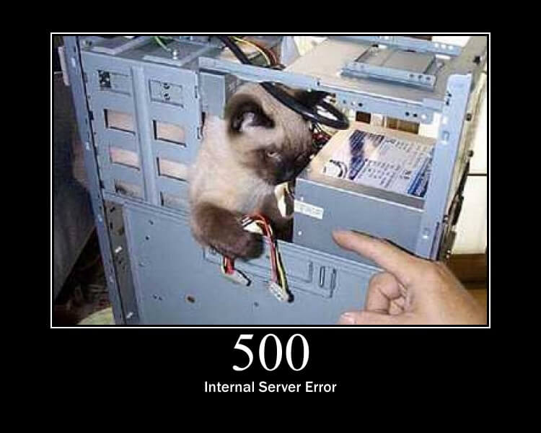
https://http.cat/
Notes:
Error on the other side. Seems like the web service you are making a request to has some issues.

Slide 24
QAs and Web Services
...based on our experiences testing web services out in the wild...

Slide 25
How testing helps
Business issues first then the presentation issues
Early feedback
Debug in different layers
Save time in retesting
More confident that the app works
Release more frequently
Lots more….
Notes:
Shiva

Slide 26
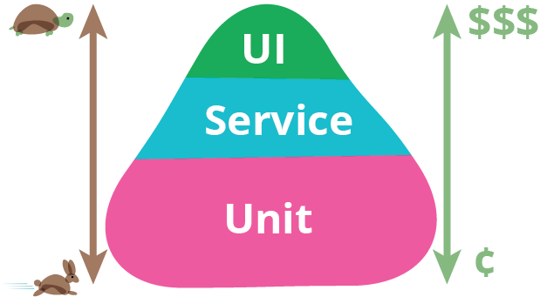
The role of QAs
Notes:
Shiva:
UNIT Testing: Talk about TDD: example of writing tests first and developing later

Slide 27
Demo - try it yourself!

Slide 28
Manual in browser test
https://api.hitbtc.com/api/2/public/ticker/DOGEBTC
Notes:
Fiona

Slide 29

Postman
Sample Postman Request:
https://api.hitbtc.com/api/2/public/ticker/DOGEBTC
Notes:
Fiona

Slide 30
curl
> curl _
Sample Curl Request:
curl -X GET https://api.hitbtc.com/api/2/public/ticker/DOGEBTC -H "Content-Type: application/json" “Accept: application/json” -i
Notes:
Shiva

Slide 31


Alternatives?
Cocoa Rest Client
IntelliJ REST Plugin
Notes:
Shiva

Slide 32
Let’s automate it! - Java
Use Library: UniRest (Java)
Sample Test Scenario
public class TestDreams {
@Test
public void testGetDreams() throws UnirestException {
System.out.println("Testing Get Dreams.....");
String url = "https://api.hitbtc.com/api/2/public/ticker/DOGEBTC";
HttpResponse<JsonNode> jsonResponse = Unirest.get(url)
.header("Content-Type", "application/json").asJson();
Assert.assertEquals(200, jsonResponse.getStatus());
Assert.assertNotNull(jsonResponse.getBody());
}
}
Notes:
Shiva

Slide 33
Let’s automate it! - Python
Use Package: Requests (Python)
Sample Test Scenario
import unittest
import requests
class TestDreams(unittest.TestCase):
def setUp(self):
self.url = 'https://api.hitbtc.com/api/2/public/ticker/DOGEBTC’
def test_should_verify_get_dreams(self):
print("Verifying Get Dreams....")
headers = {"Content-Type": "application/json"}
res = requests.get(url=self.url, headers=headers, verify=False)
self.assertEqual(200, res.status_code, "Response code doesn't match")
self.assertTrue(res.json())
Notes:
Shiva

Slide 34
Closing notes
...time flies when you’re automating tests...

Slide 35
Suggestions
Automate as you go
Cross role pairing
Integrate with build pipeline
If the service is broken no need to test UI
Spread the word! :)
Notes:
Shiva:
Automate as you GO: Automate in parallel any other activies(Manual)
Cross Role : Code Review, Stop a Bug before being raised , Developers as well can Test , Pairing with BAs can encounter which is missing in the business flow.

Slide 36
Key Take Aways:
What Web Services are and why we use them
How to test a Web Service in multiple ways
Increased familiarity with test automation
Notes:
Fiona

Slide 37
Questions
?
Notes:
Both

